Slide 1
Transformer-based RAG QA-Assistant
Ali Ashraf
Youssef Ehab
Youssef Yasser

Slide 2
Introduction
Imagine you’re building a Question-Answering assistant that must understand long documents , research papers, legal contracts, technical manuals, and return answers grounded only in the source text. Traditional search tools give you keywords. Basic neural networks struggle with long-range dependencies. But modern Transformer models shine in this setting.

Slide 3
Our Solution
We built a Retrieval-Augmented Generation (RAG) system powered primarily by Transformer models to deliver accurate, context-grounded answers from long unstructured documents (PDF/DOCX).

Slide 4
Why Transformers + RAG?
Superior Semantic Retrieval
Transformers capture deep contextual meaning, enabling highly accurate document matching.
Context-Grounded Answers
Retrieved evidence is injected directly into the model’s input, producing fact-based responses.
Reduced Hallucination
RAG constrains the model to answer using only retrieved, relevant knowledge.
Scales with Large Knowledge Bases
Efficient vector search (FAISS or similar) allows retrieval from millions of documents with low latency.

Slide 5
RAG PIPELINE
Text Ingestion & Preprocessing
PDFs/DOCX → cleaned text → chunked for retrieval
Embedding Generation
Transformer sentence embeddings for semantic representation
Vector Retrieval Layer
FAISS (or alternative) for fast similarity search
Transformer Generation
Generates context-grounded answers using retrieved evidence
Evaluation
Measures relevance, accuracy, and retrieval quality

Slide 6
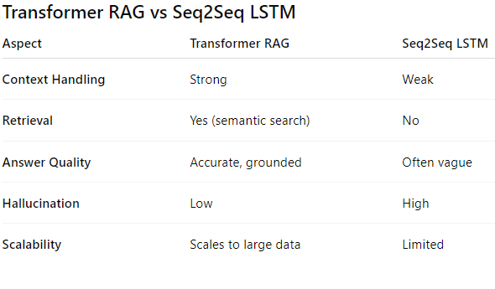
Transformer RAG vs Seq2Seq LSTM

Slide 7
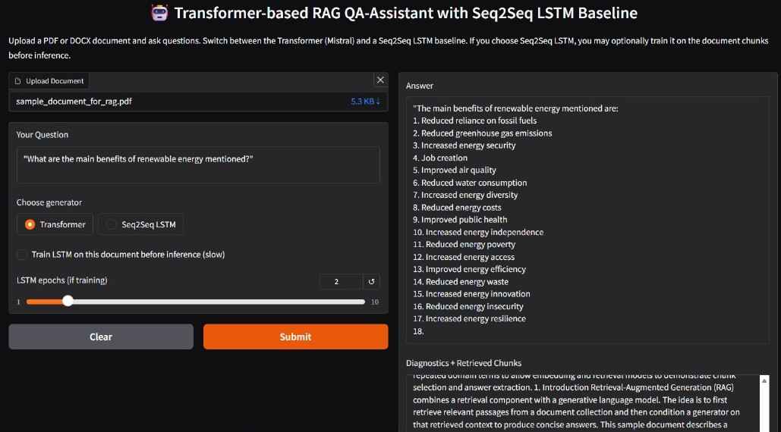
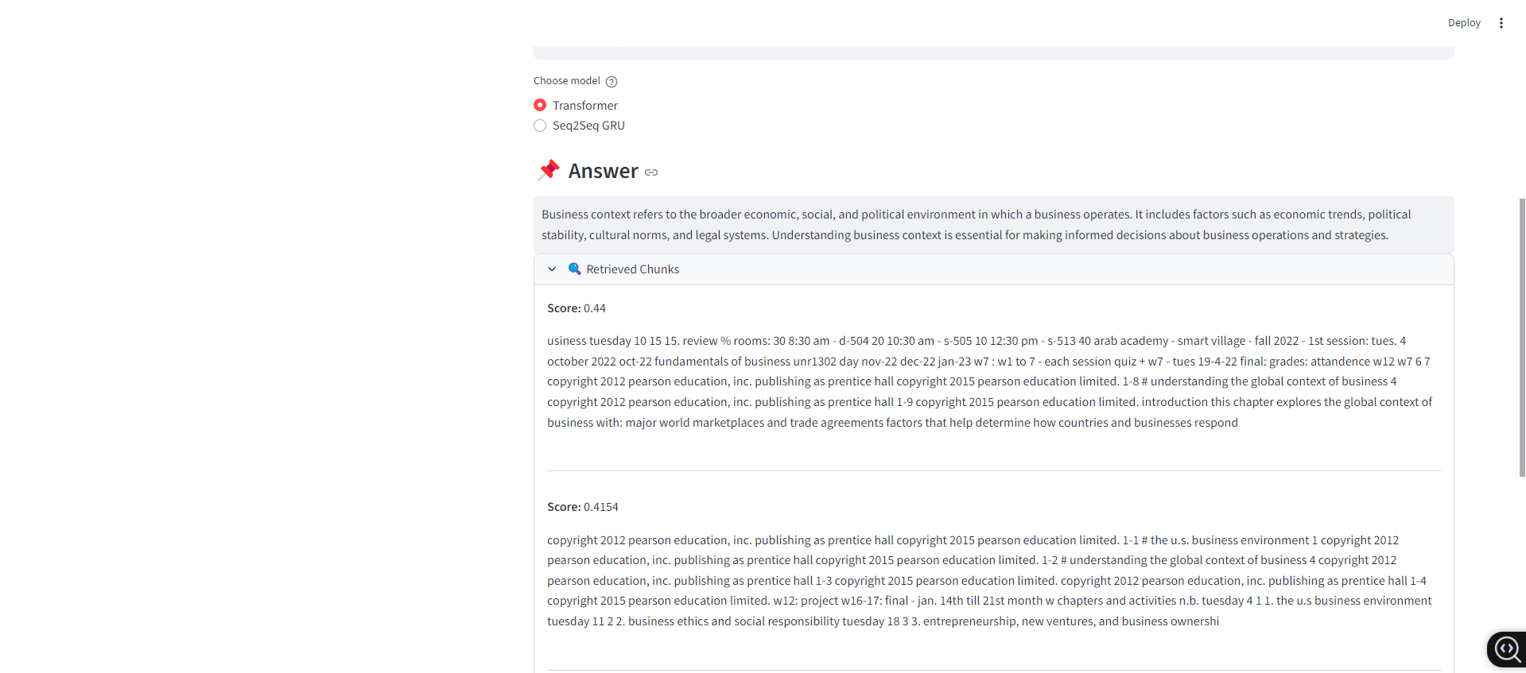
Transformer Output

Slide 8
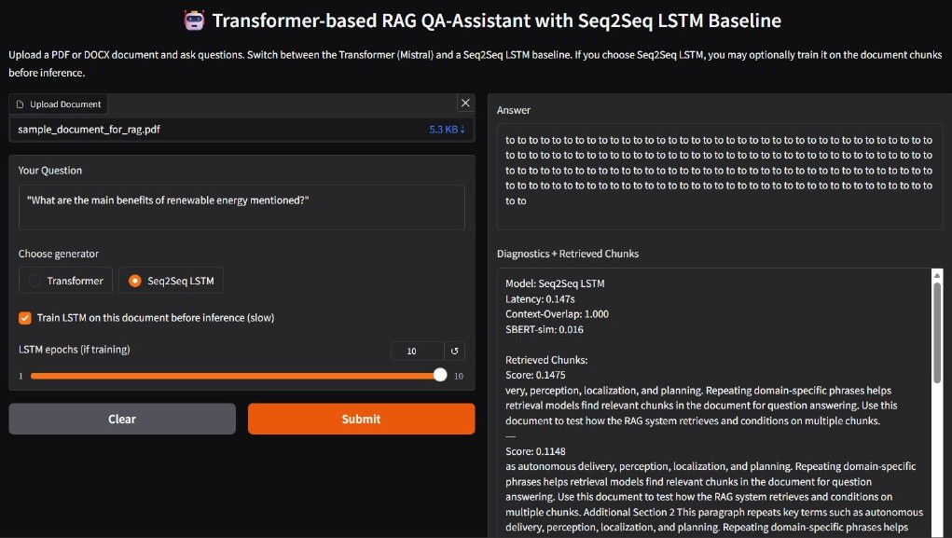
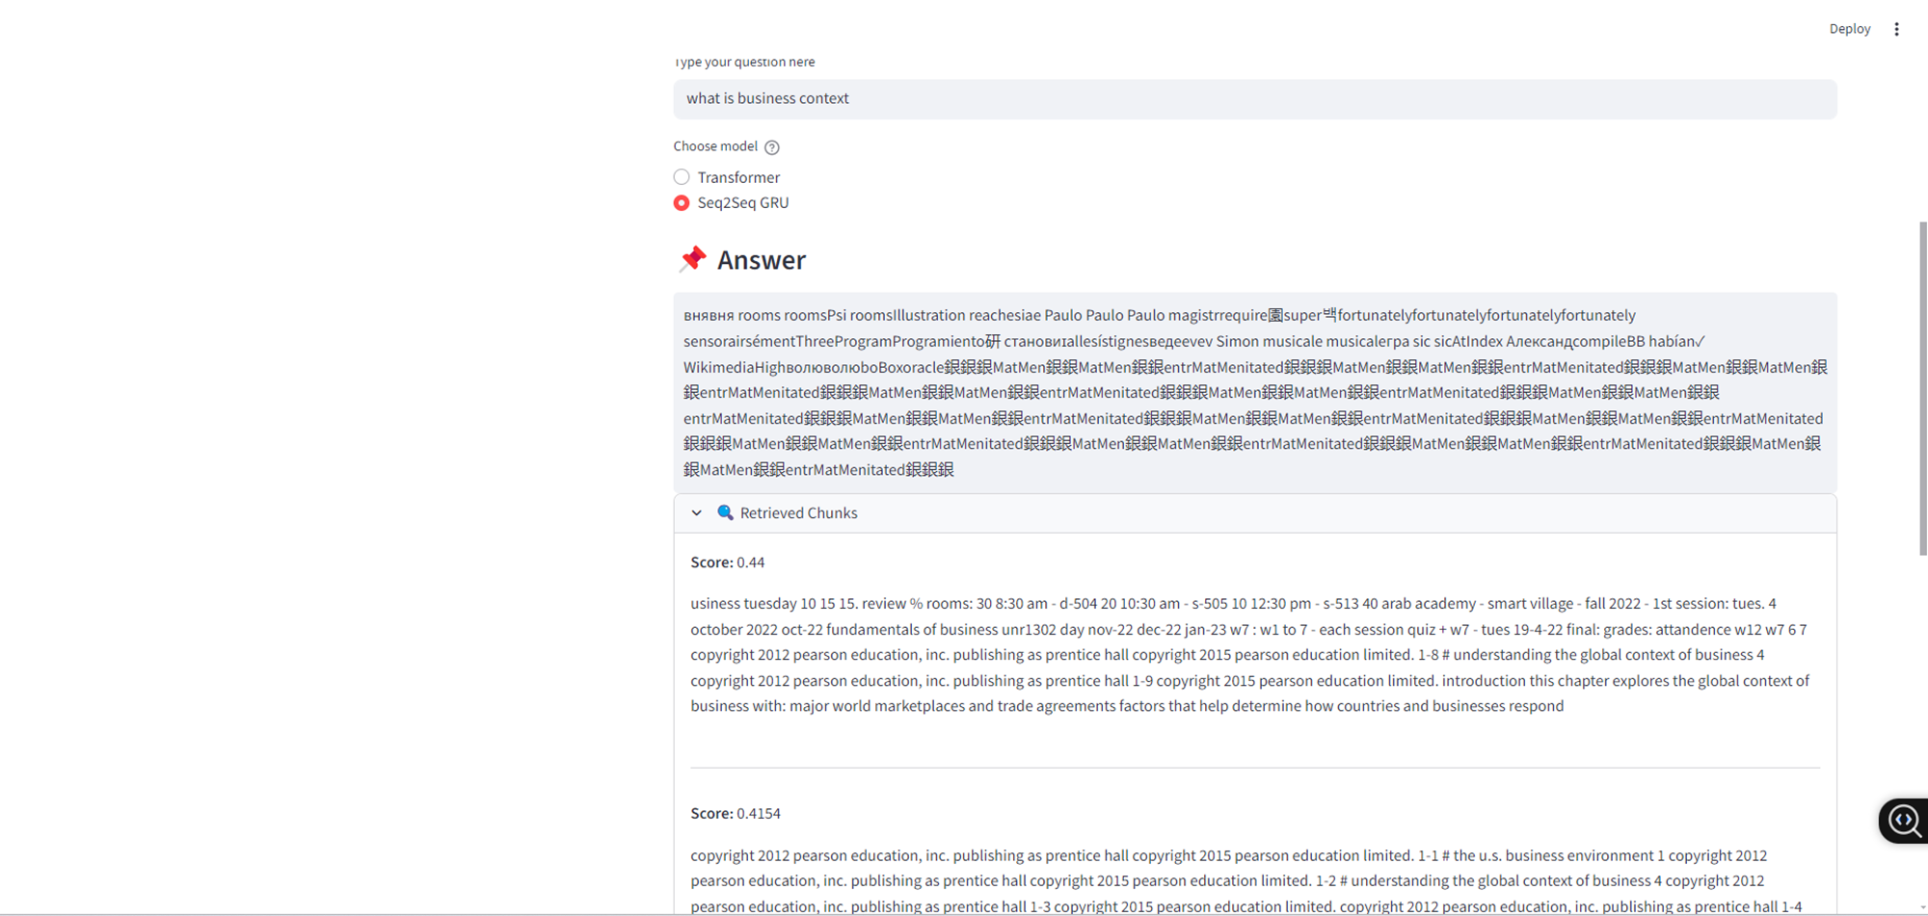
SEQ2SEQ output

